Slide 1
Dynamic Partial Reconfiguration
Eng. Amr Alaa
Prof. Mohamed Abd El-Ghany

Slide 2
What is Dynamic Partial Reconfiguration?
Partial Reconfiguration (PR) is a feature of some FPGAs that allows you to dynamically modify blocks of logic by downloading partial bitfiles while the remaining logic continues to operate without interruption.
This can be particularly useful in systems where hardware functionality needs to change on the fly, or resources are scarce and over provisioning is not an option.
DPR was rebranded as “Dynamic Function eXchange” (DFX) by Xilinx in 2020.

Slide 3
What is Dynamic Partial Reconfiguration?
In Xilinx FPGAs and Vivado, the Partial Reconfiguration feature can be used to create reconfigurable partitions, which are portions of the design that can be independently synthesized, implemented, and downloaded to the FPGA.
The rest of the design, known as the static region, remains unaffected during this process.
The ports of the modules to be reconfigured must match completely, i.e. same port names, datatype, number of ports, port type (in/out/inout).
Partial: The main bitstream is downloaded and then partial bitstream is downloaded manually
Dynamic partial: The main and partial bitstream are on the FPGA Ram and switching is done automatically “Requires a processor on the board”

Slide 4
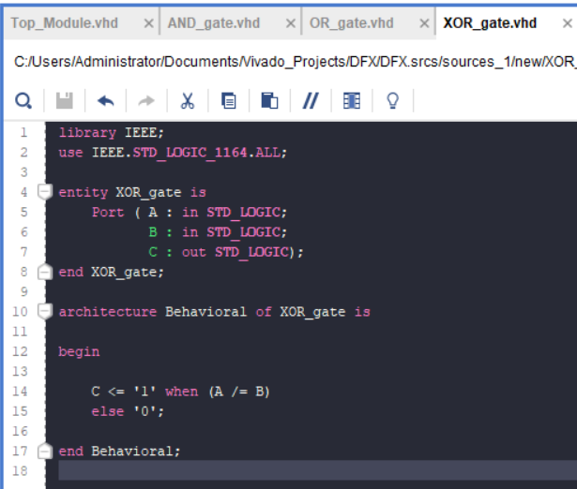
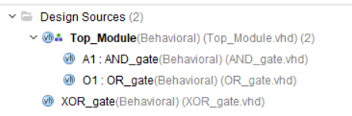
Dynamic Partial Reconfiguration Steps in Vivado

Slide 5
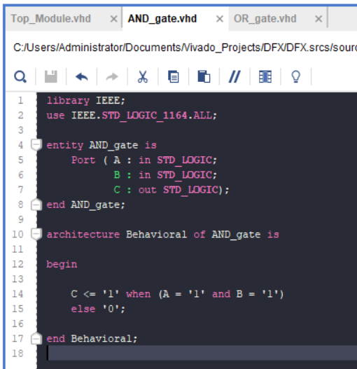
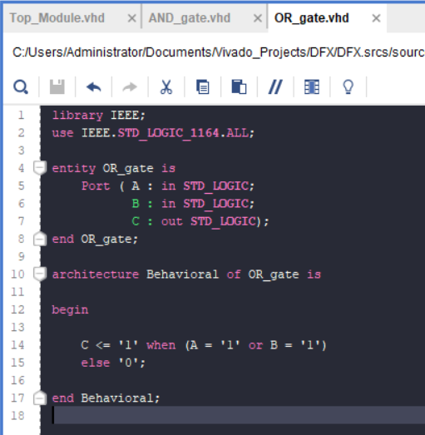

Slide 6
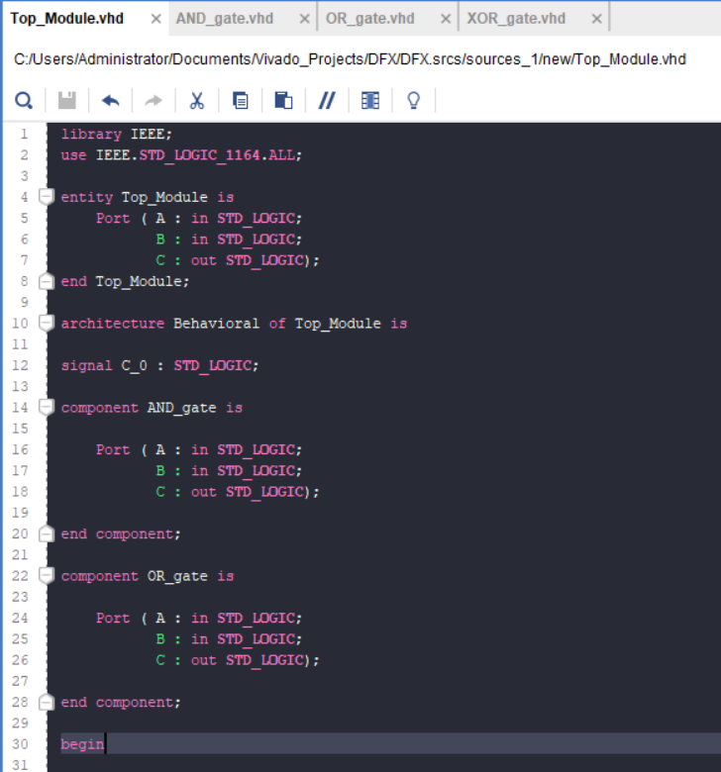
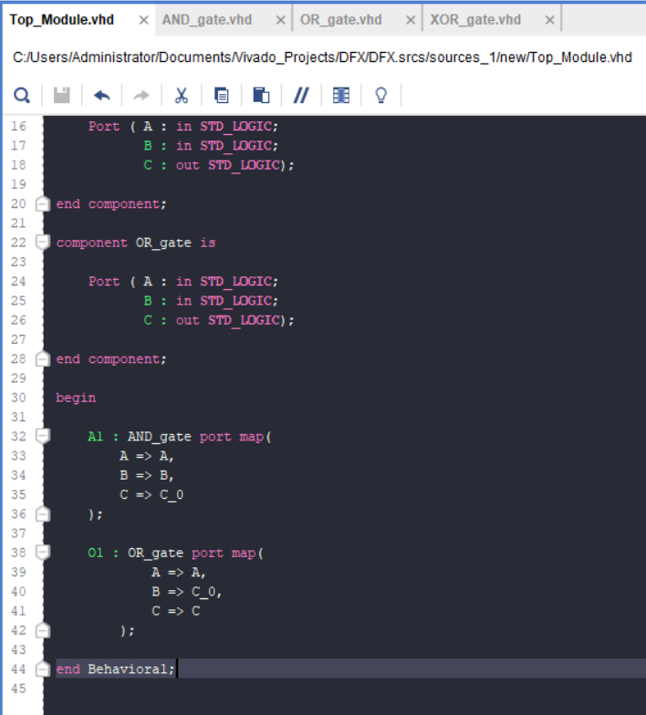

Slide 7
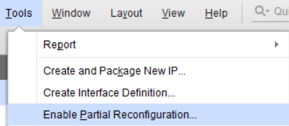
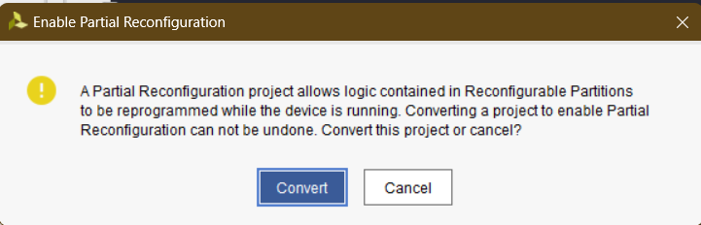

Slide 8
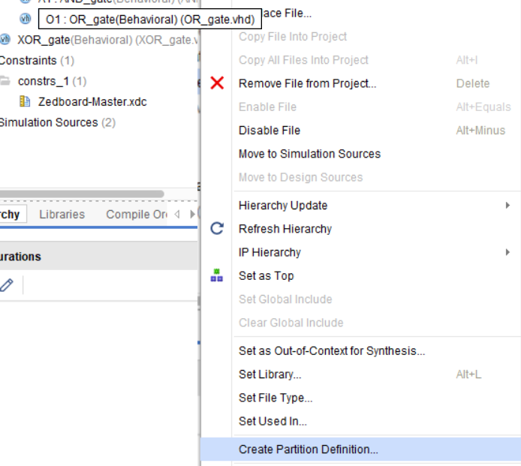
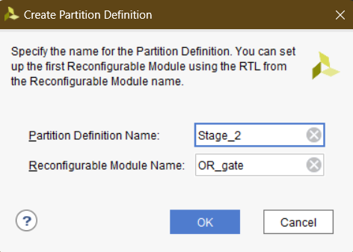
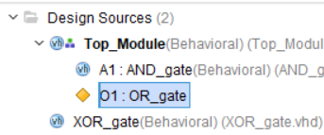

Slide 9
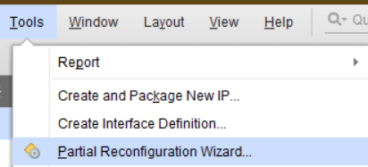

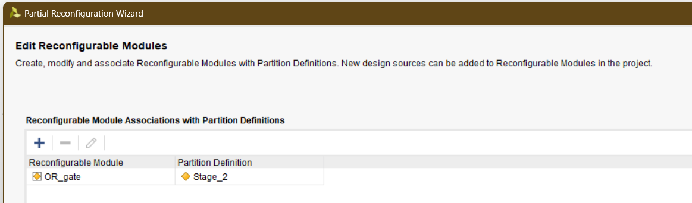

Slide 10
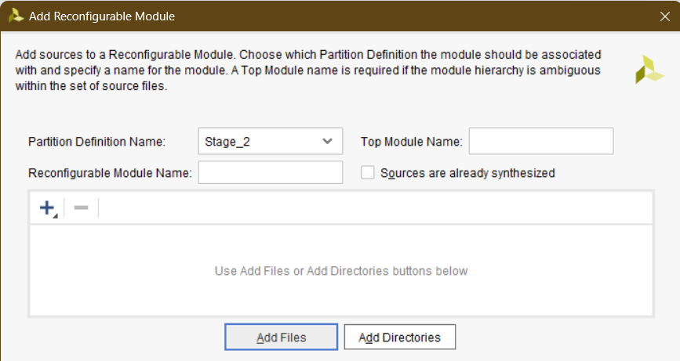
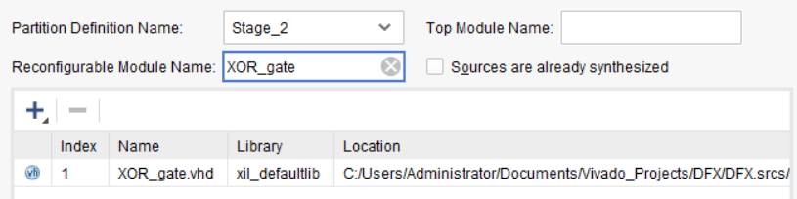

Slide 11
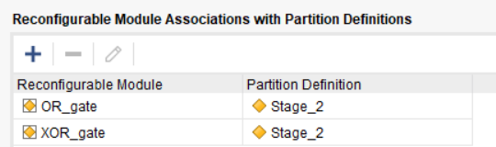
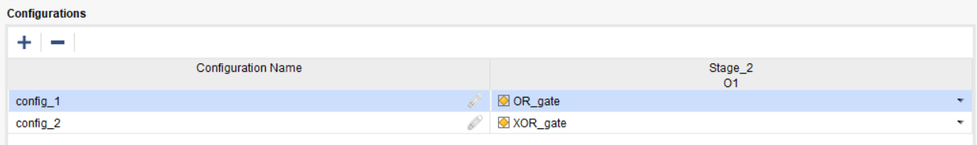
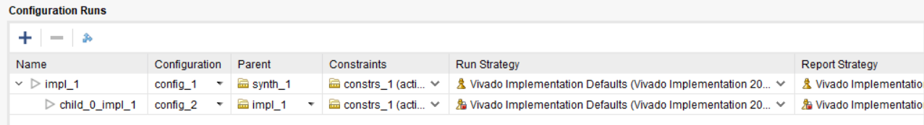

Slide 12
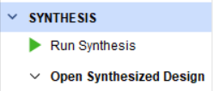
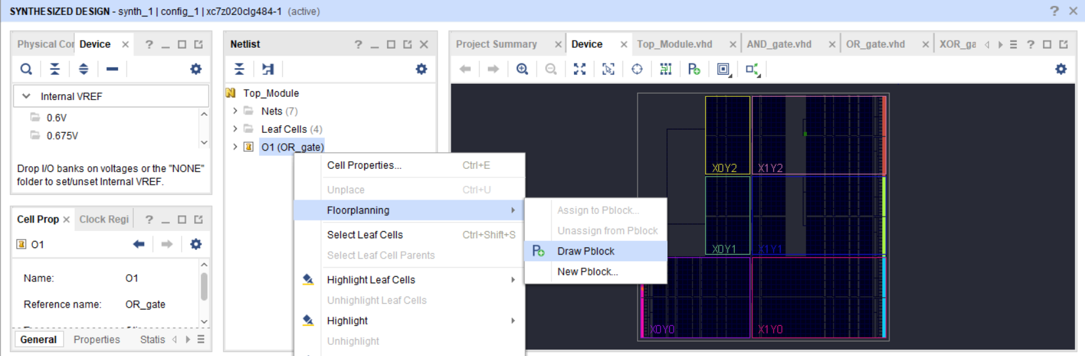

Slide 13
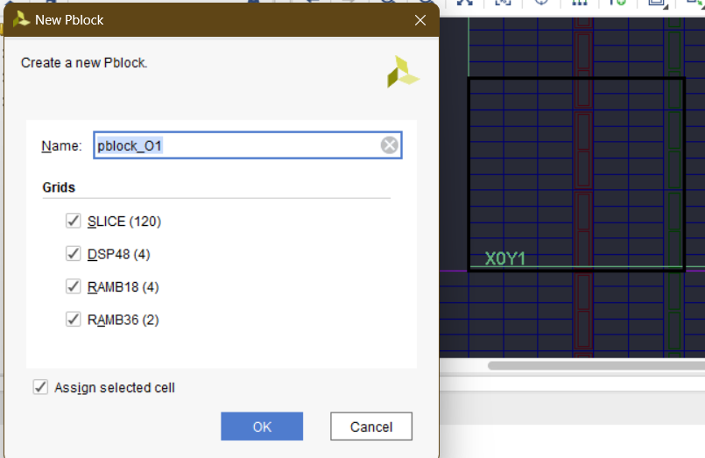
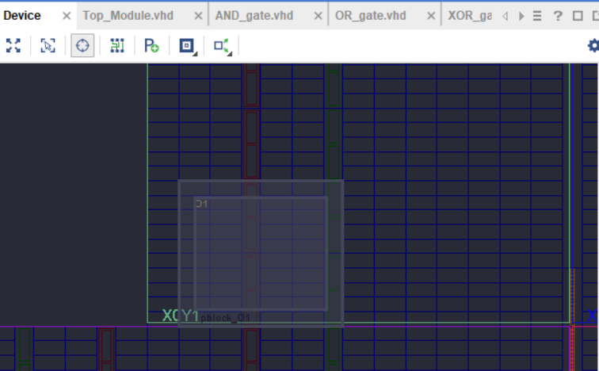
The P-block should not be at the edge of the device fabric to avoid DRC errors.

Slide 14
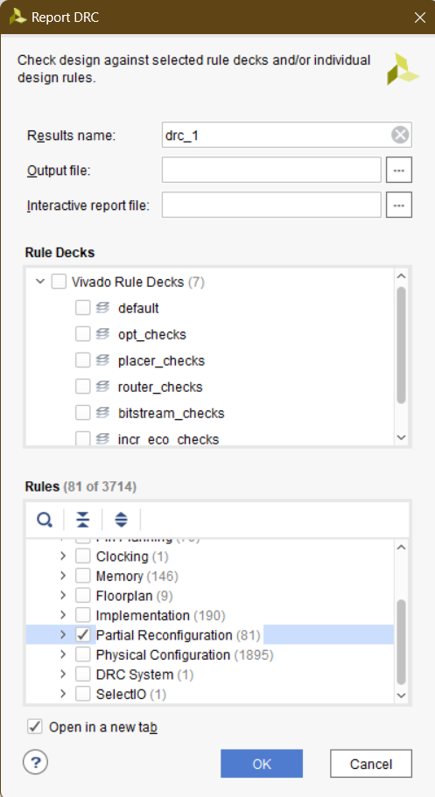
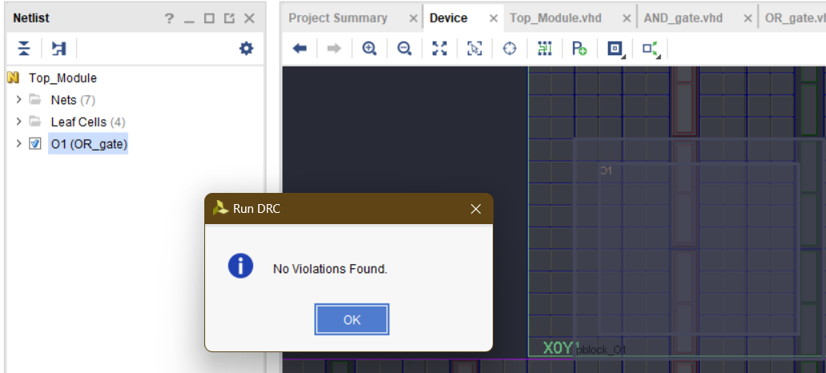

Slide 15

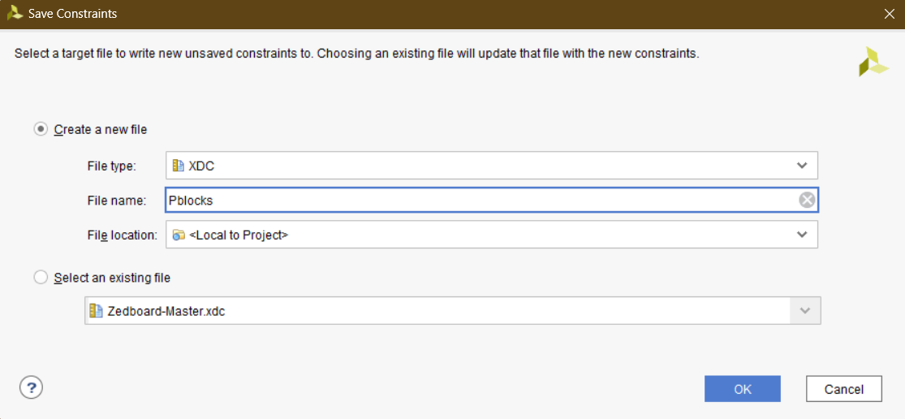

Slide 16
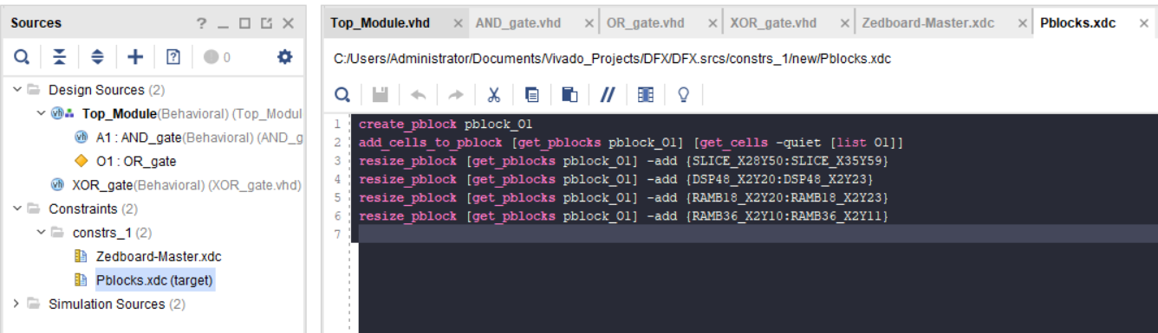
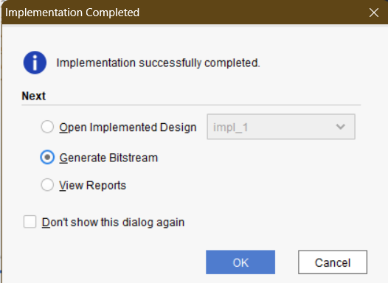

Slide 17
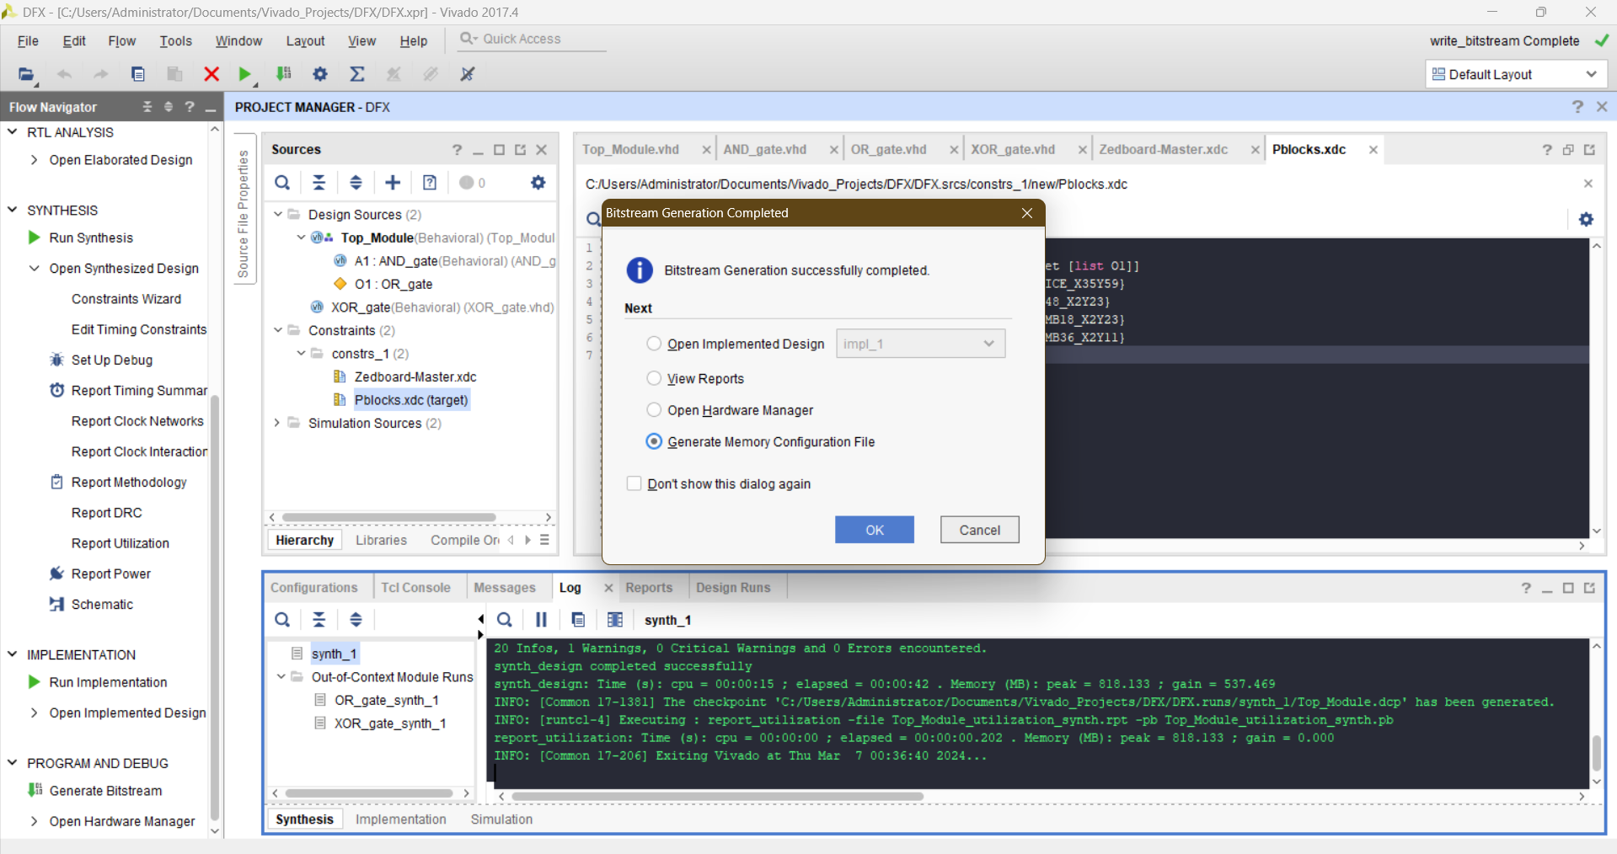

Slide 18
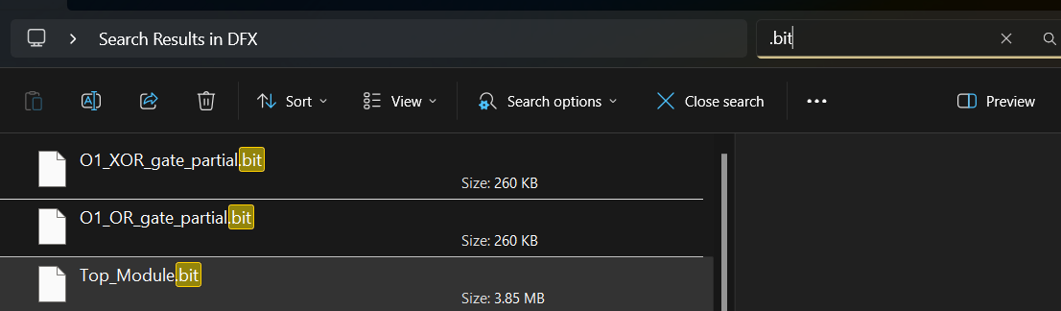
Search for the “.bit” extension in the project’s folder to locate the bitstreams.
Finally, program the FPGA using the static bitstream first (Top_Module.bit), then either of the partial bitstreams to switch functionality while the static module’s operation is uninterrupted.

Slide 19
Task
Create an ALU that utilises the adder and multiplier synthesised by HLS from Task 1.
Use DPR to switch dynamically between the multiplier and divider, while the adder remains functional.
The operation of the adder, known as the static region, should remain unaffected during reprogramming.

